Slide 1
UML Design
Number Guessing Game App

Slide 2
UML Use Case Diagram
Registration Interface
Login & Logout
Game Levels (Easy, Medium, Hard)
Game Guessing Interface
Leaderboard
Attempt Count
Timer
Database
Number Guessing Game App with the following features

Slide 3
A TEXT-BASED UML REPRESENTATION

Slide 4
Actors
User - Represents the player who interacts with the game.
System (Game Engine) - Handles the game logic, registration, authentication, and leaderboard.
Database - Stores user data, game progress, and leaderboard scores.

Slide 5
Use Cases and Relationships

Slide 6
User Interactions:
<<includes>> Register (User → System)
<<includes>> Login (User → System)
<<includes>> Logout (User → System)
<<includes>> Select Difficulty Level (User → System)
<<extends>> Easy Mode
<<extends>> Medium Mode
<<extends>> Hard Mode

Slide 7
<<includes>> Play Game (Guess a Number) (User → System)
<<includes>> Timer (Game Engine)
<<includes>> Attempt Count (Tracks the number of guesses)
<<includes>> View Leaderboard (User → Database)
<<includes>> Store Game Results (System → Database)

Slide 8
Description of Relationships:
User → Register → Allows a new user to create an account.
User → Login → Authenticates the user before playing.
User → Logout → Ends the user session.
User → Select Difficulty Level → Player selects a difficulty setting.
Extends: Easy, Medium, and Hard modes depend on selection.
User → Play Game (Guess a Number) → Main game interaction.
Includes: Timer and Attempt Count to track gameplay.
User → View Leaderboard → Displays top scores from the database.
System → Store Game Results → Saves game progress to the database.

Slide 9
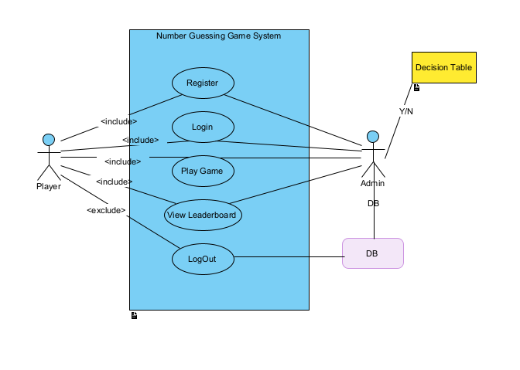

Slide 10
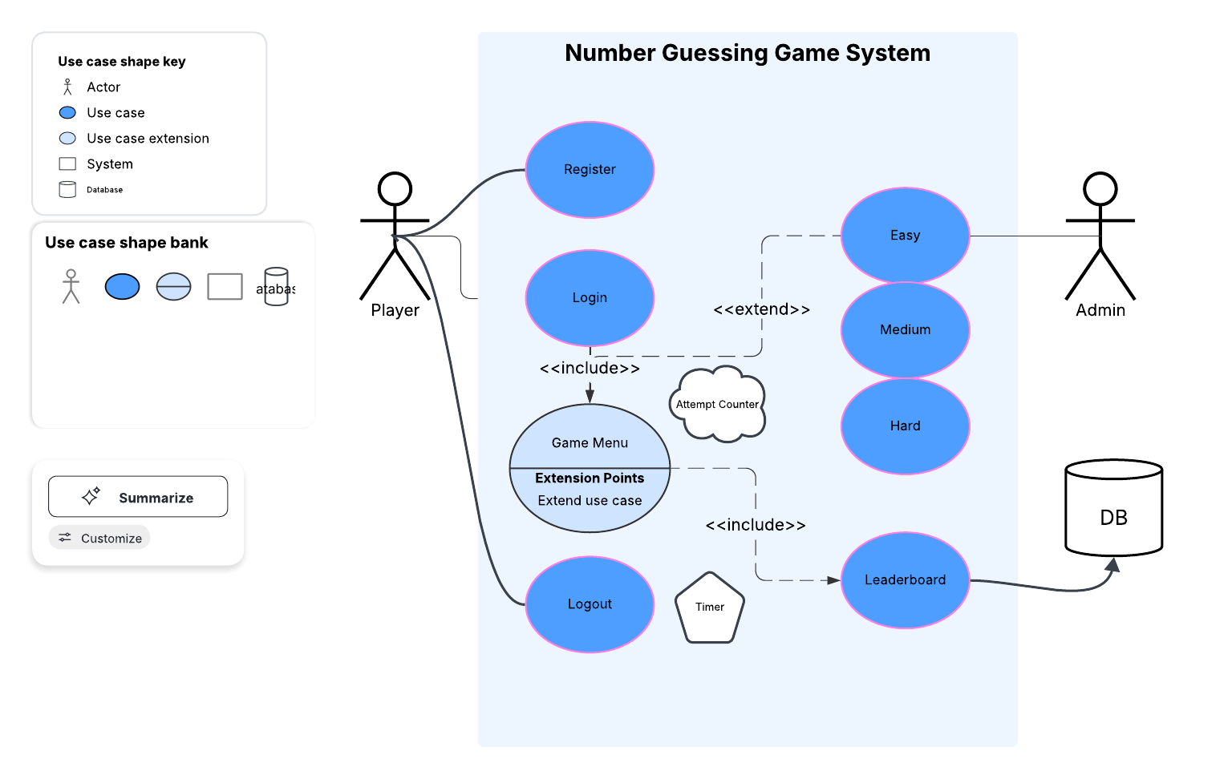

Slide 11
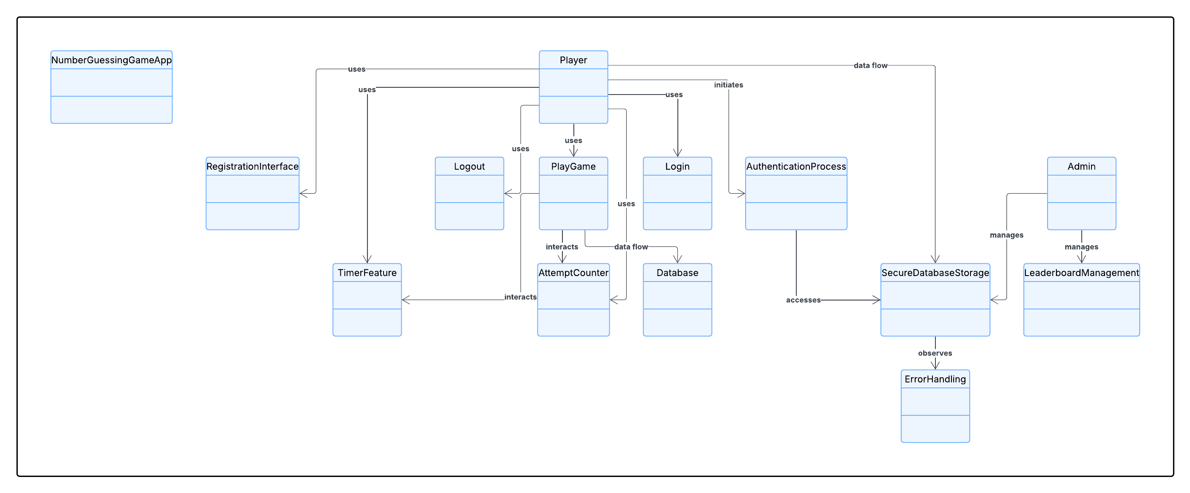

Slide 12
UML Class Diagram

Slide 13
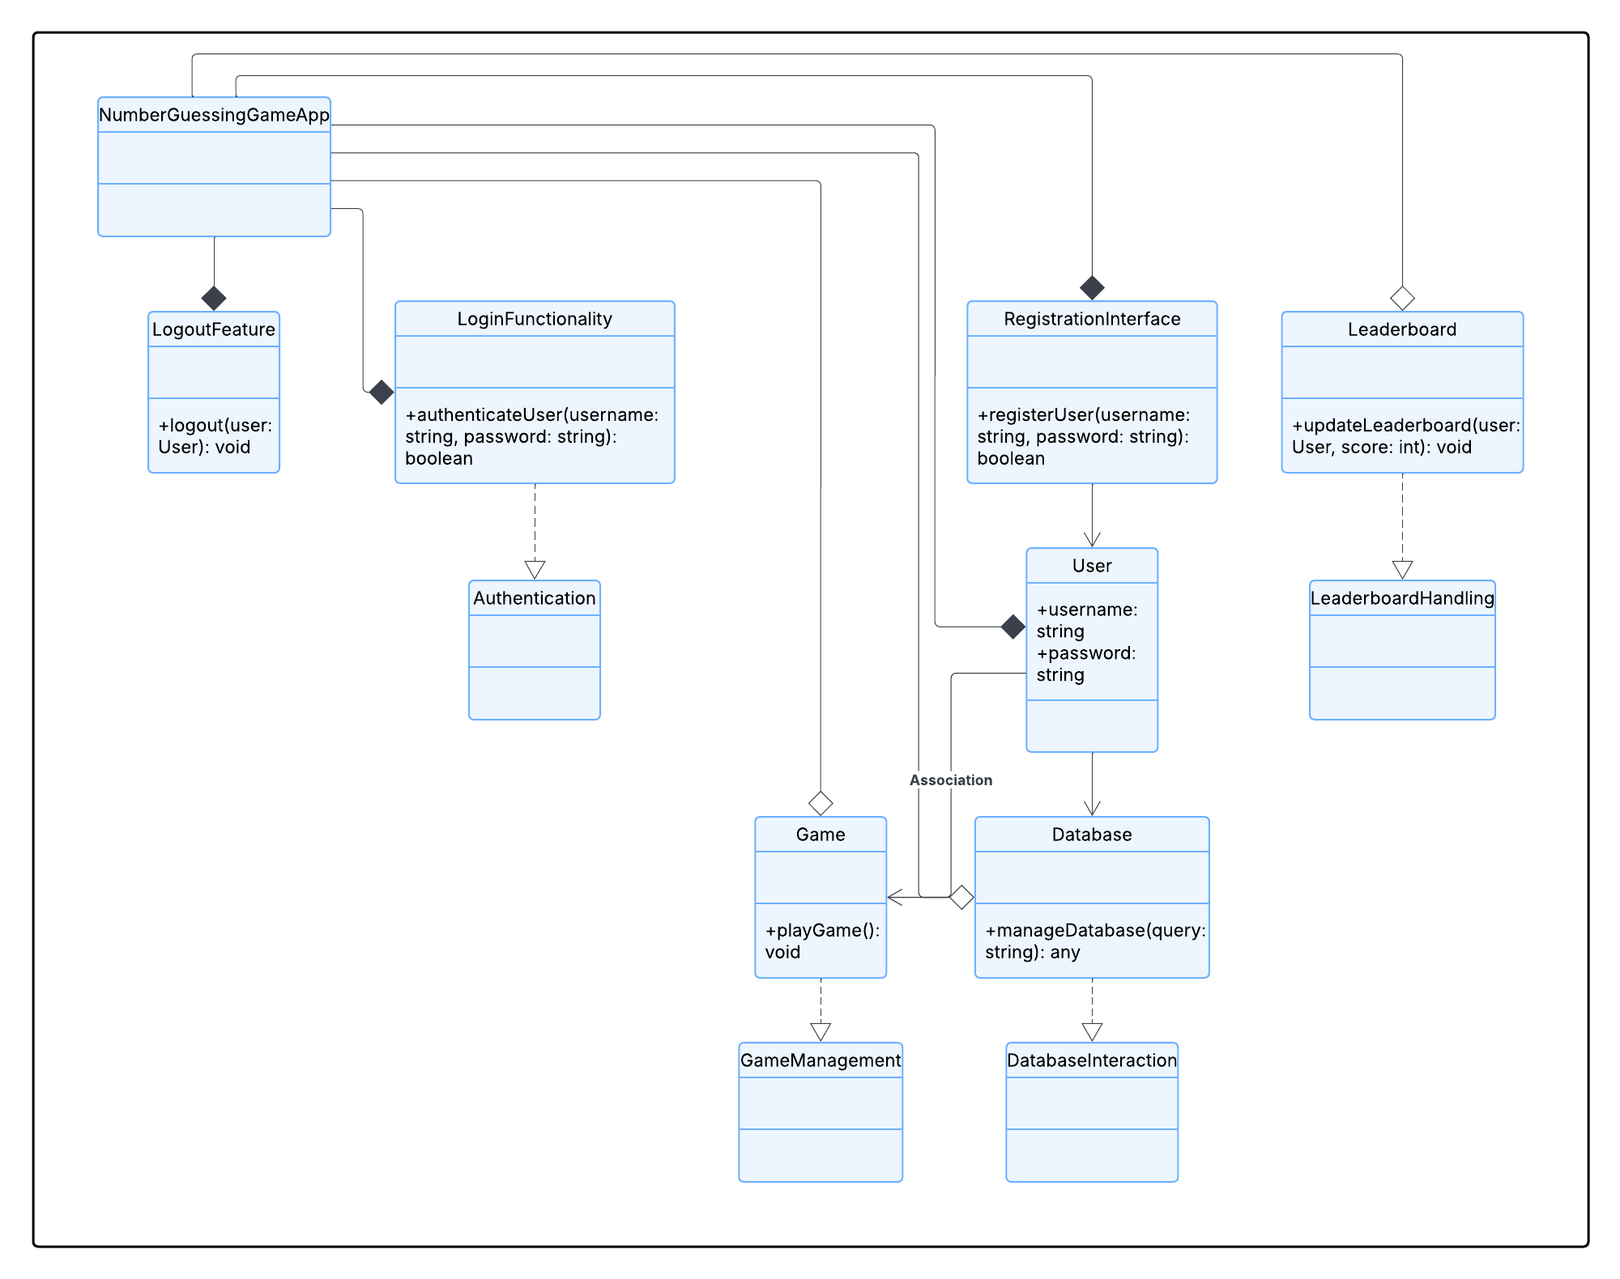

Slide 14
UML Design Using Interactive Diagram

Slide 15
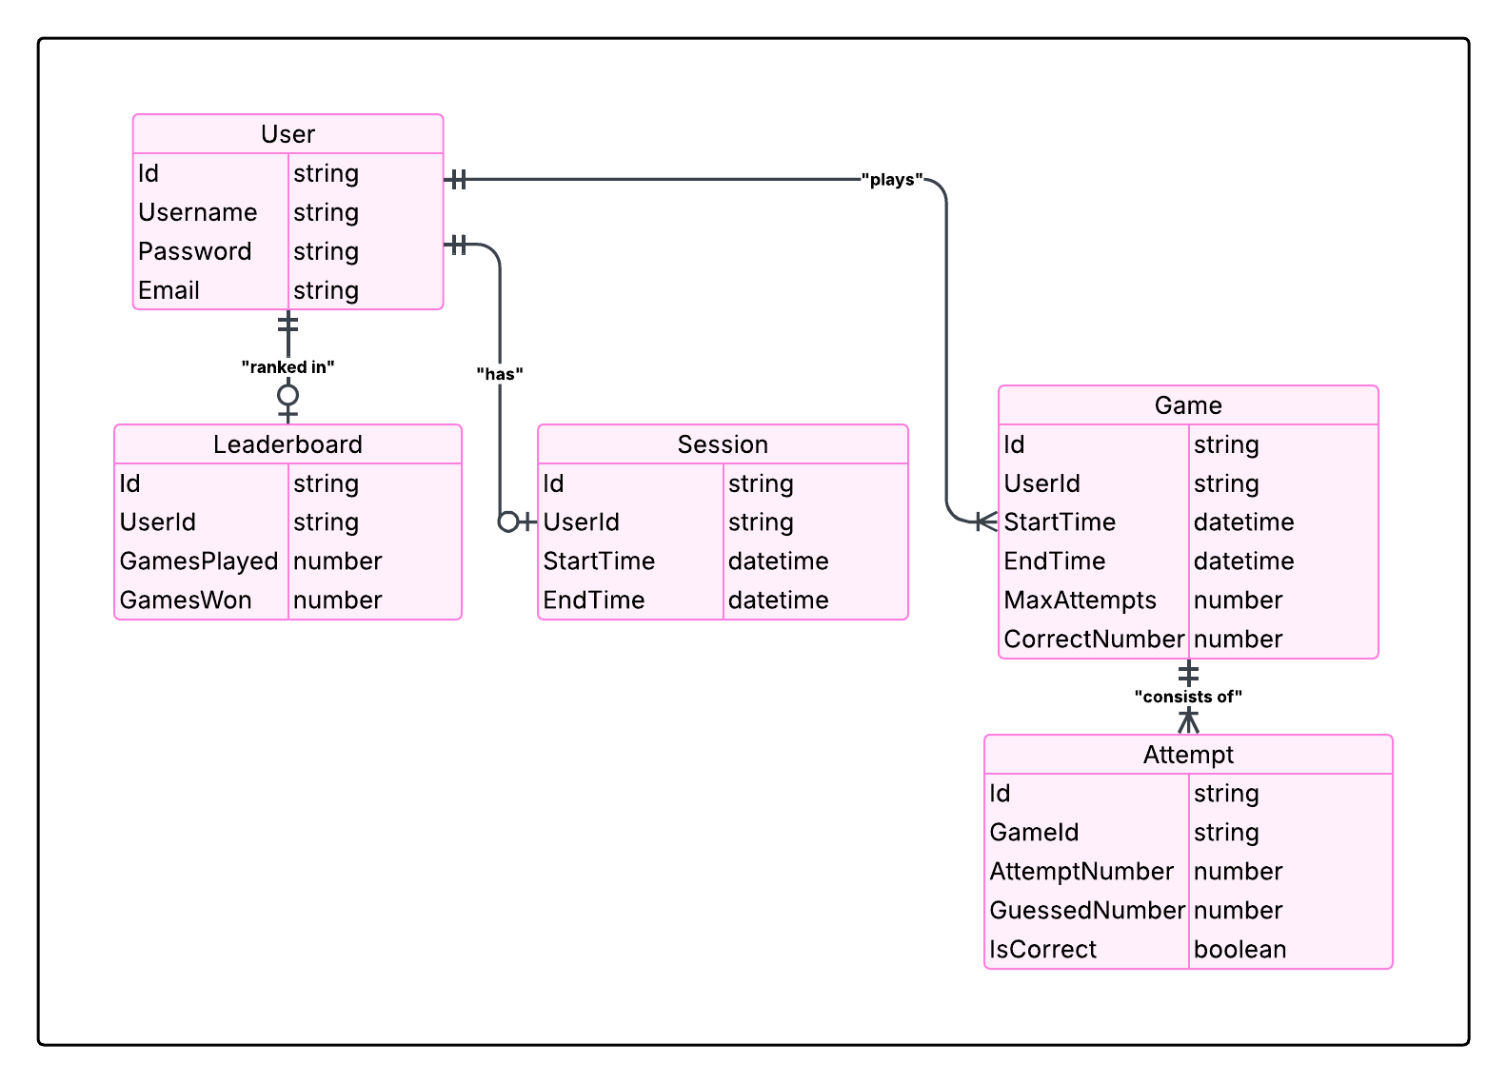

Slide 16
UML Sequence Diagram

Slide 17
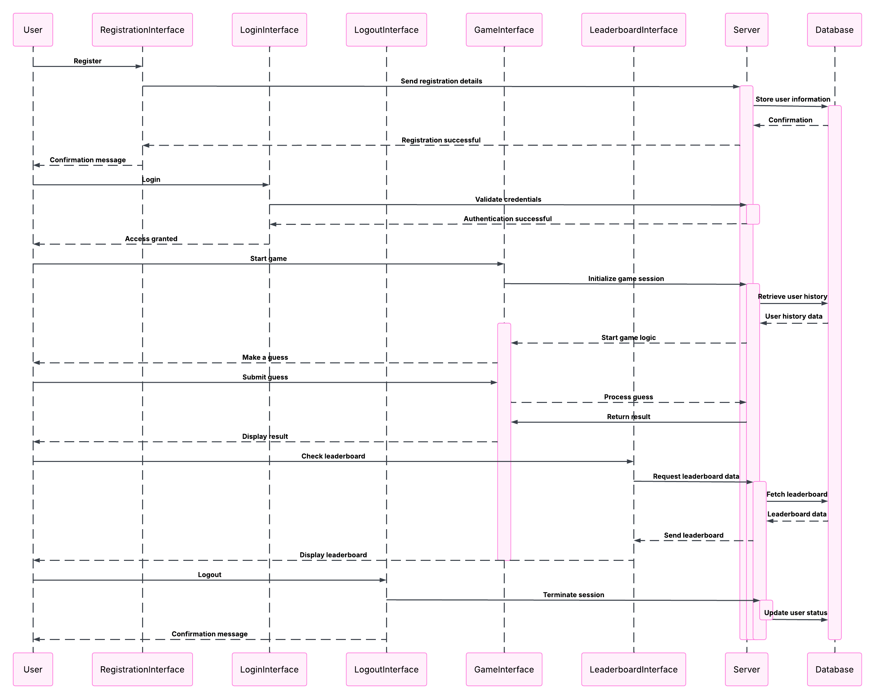

Slide 18
FLOWCHART

Slide 19
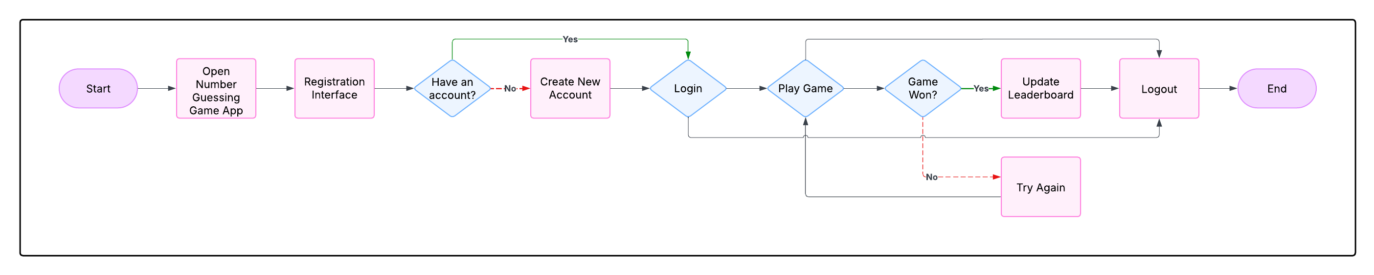

Slide 20
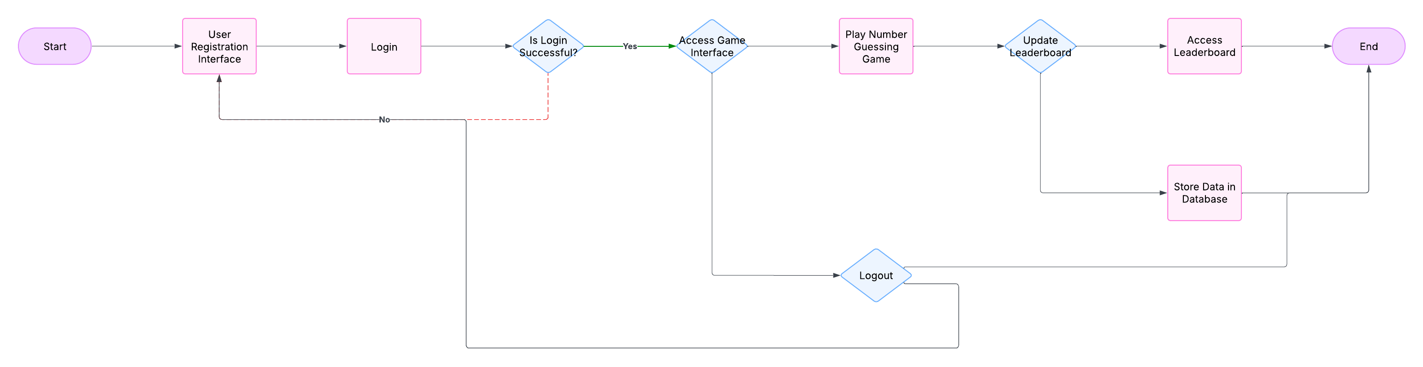

Slide 21
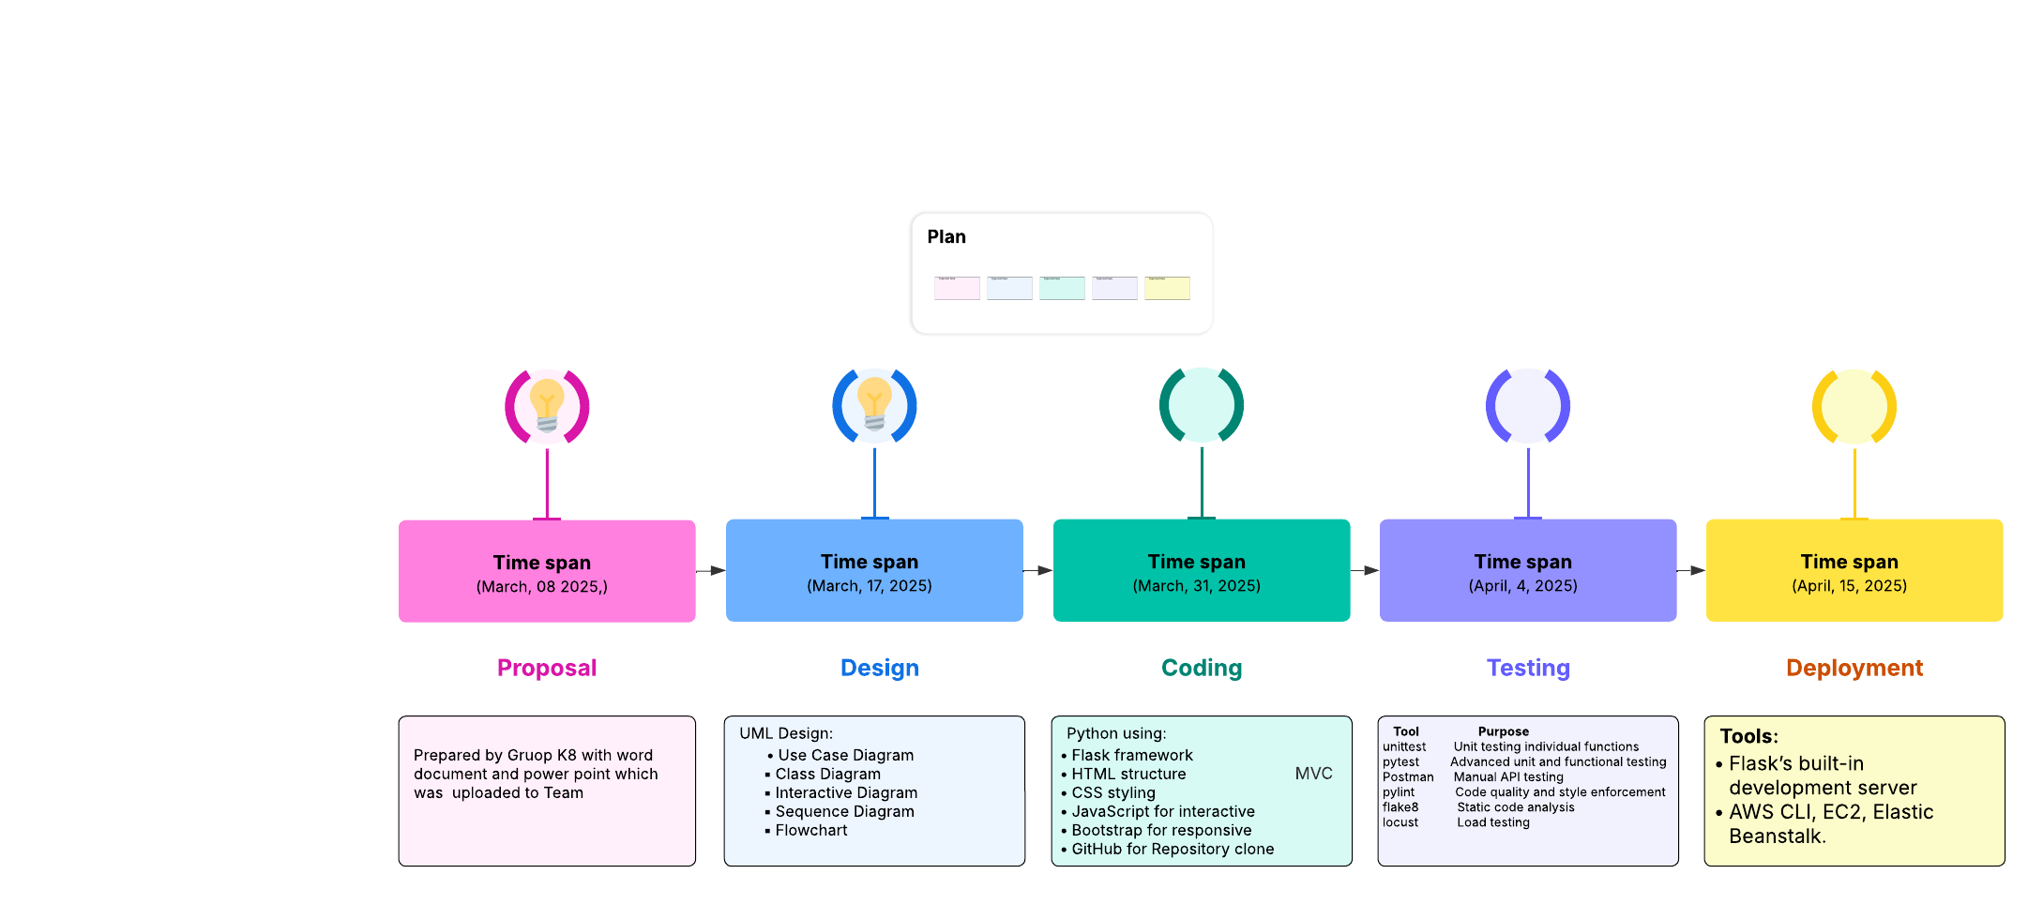

Slide 22
UML Dummy Diagrams

Slide 23
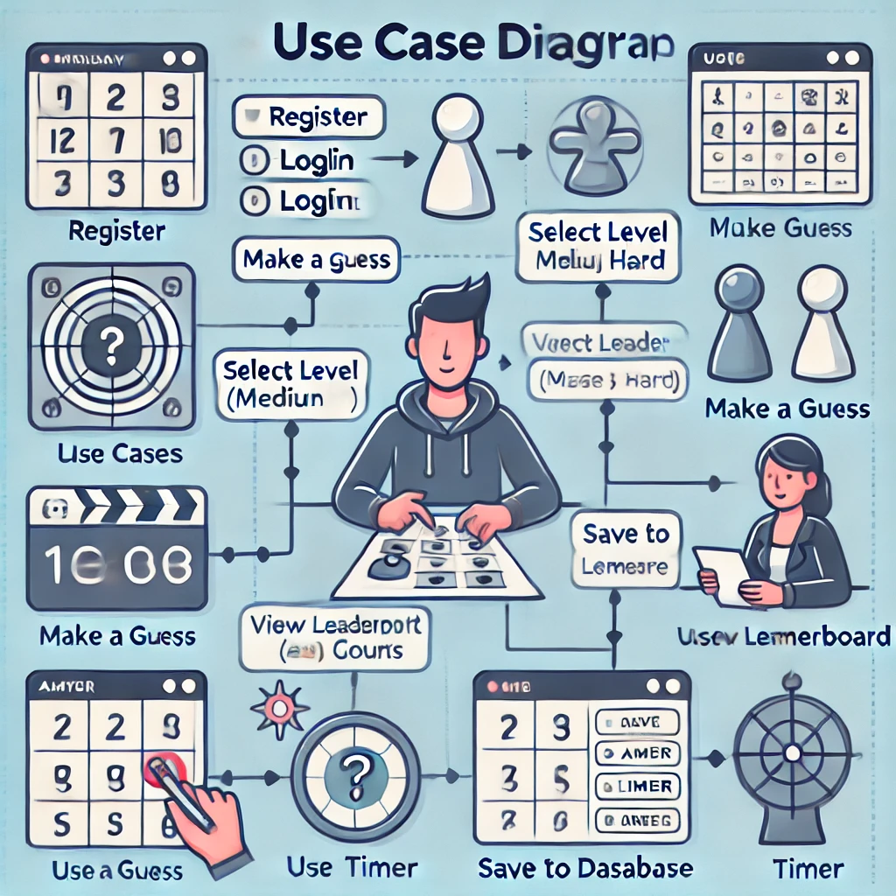

Slide 24
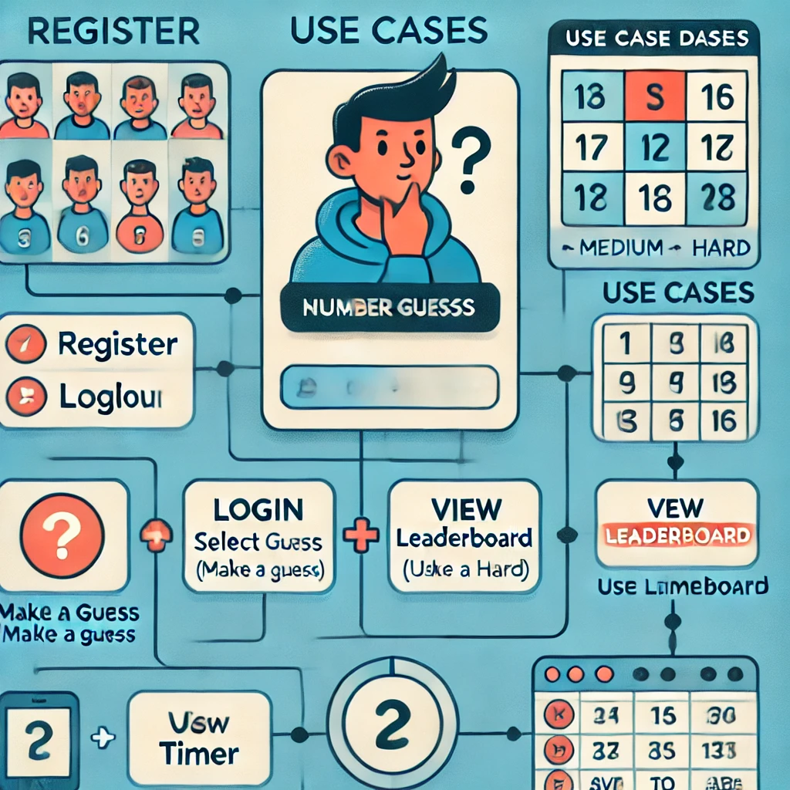

Slide 25
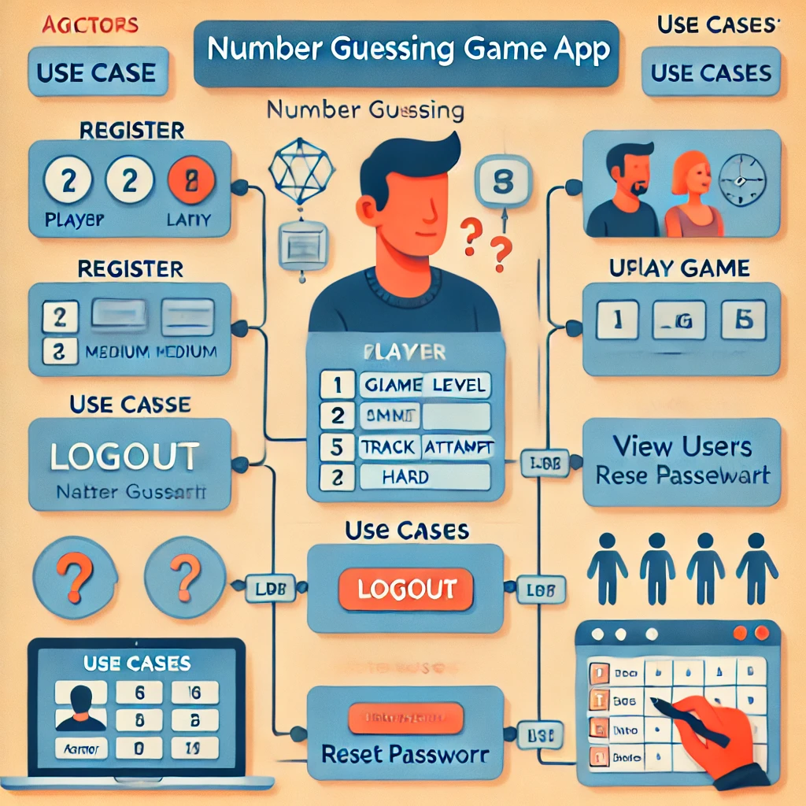

Slide 26
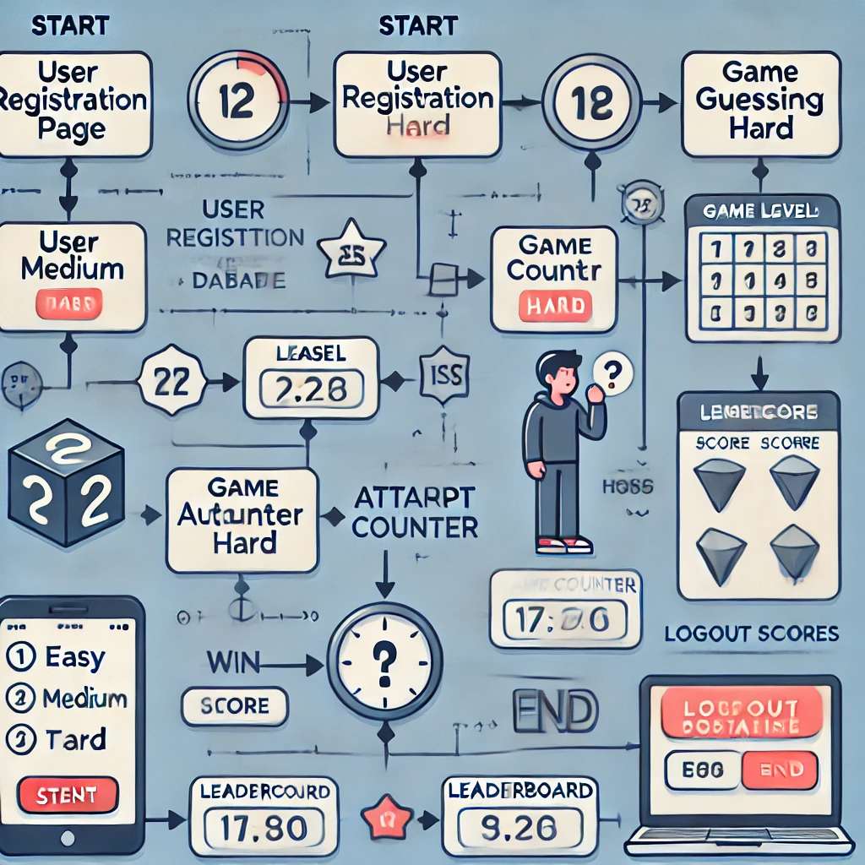

Slide 27
BLOCK DIAGRAM

Slide 28
